Slide 1
Presentation On 3D/2D Games
By
Name –Amit Soni
Experience – 7 years
Skills – Unity 3D/2D, J2ME, Cocos2DX Game Engine

Slide 2
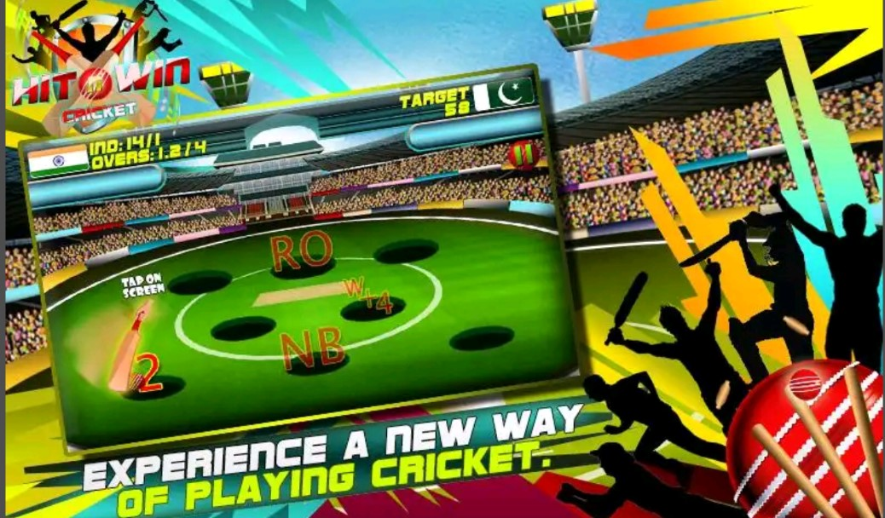

Hit N Win Cricket
This game offers you the chance to bat always. You will have an auto generated score to chase always.
This game also allows you to choose both teams from the top cricket playing nations. You can choose number of overs from 3, 6, 9 and 12. Playing of the game is simple.
Worked on full game play [Cocos2DX].

Slide 3

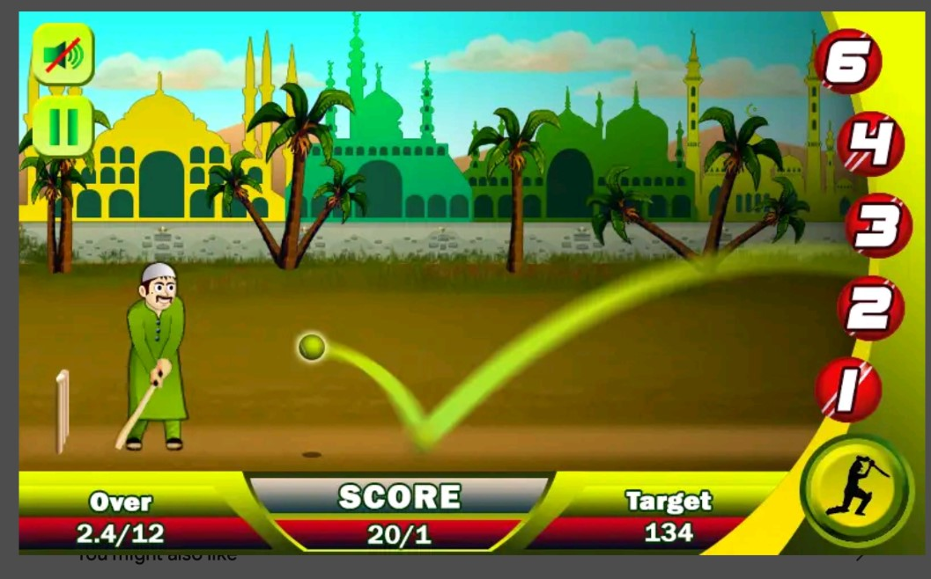
Ramzan Cricket
Ramzan Cricket is specially developed and designed for Ramadan festival. Experience a new format of fast cricket game.
After selecting overs from 3/6/9/12 you will get an auto generated target to chase. Simple playing controls make the game easy and challenging. You can choose your favorite avatar from 8 different characters
if you hit timely you will get 6/4/3/2/1 runs if you missed the ball you might lose the wicket.
Worked on Full Game Play. [Cocos2DX]

Slide 4
Monkey Dozer
A classic coin pusher with a twist.
Collect sets of 5 ninjas to collect trading cards from the 5 tribes of Boojabunga.
https://play.google.com/store/apps/details?id=com.threemonkeygames.MonkeyDozer&hl=en
Worked on Game Play.

Slide 5
Real Euro Train Simulator - 3
Real Euro Train Simulator is free train driving games of 3D trains & railroad simulation. Android game of high-speed trains & real train driver experience and immediate track changing system.
You can drive Bullet, Euro, Steam, Locomotive trains
https://play.google.com/store/apps/details?id=com.game.realeuro.trainsimulator
Worked on Environment setup, UI and Game Play.

Slide 6
Namaste England - Simulator an
3D Bus, Ship, Truck Simulator & Driving Game on Bollywood Movie released in the year 2018-2019.
Namaste England game provides a realistic feel of driving a Bus, Jeep, Truck or even Sailing a Ship and a Boat across countries
https://play.google.com/store/apps/details?id=com.aaryavarta.namaste.england

Slide 7
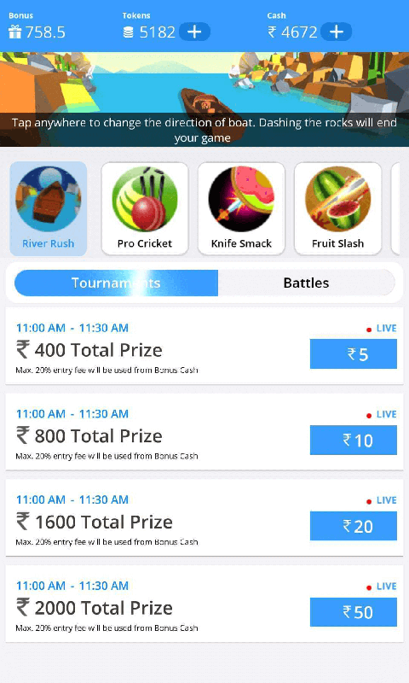
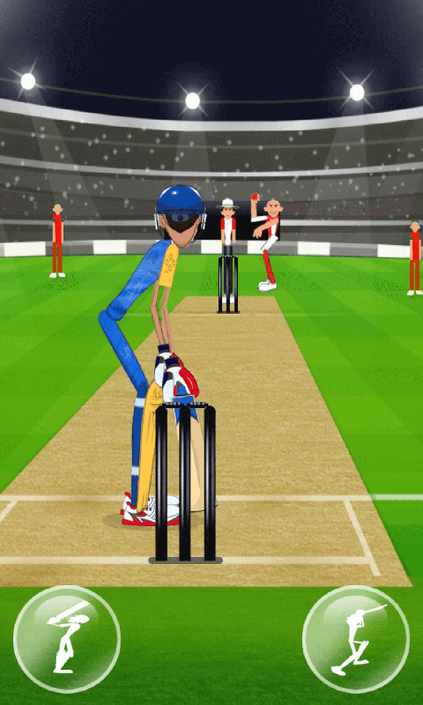
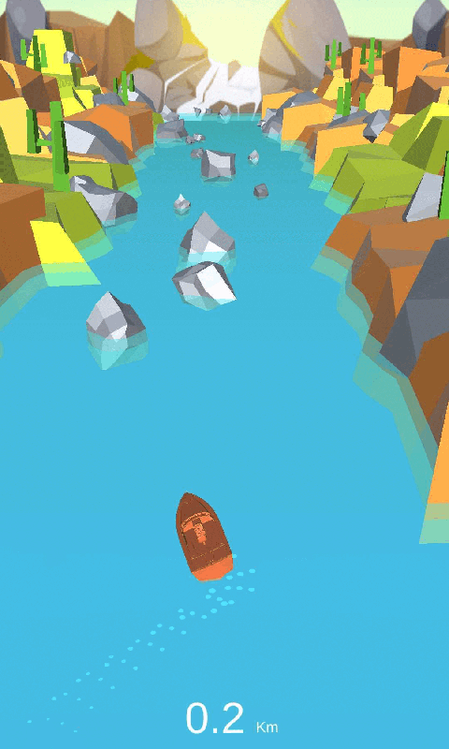

KhelFactory
Khel Factory is the only place where you get Paid for playing your favorite Games, Our Top Games are just one click away to Earn Cash daily.
Most games are available in Tournament and battle mode.
Play skill games and start earning money.
Worked on All Game’s.

Slide 8
FirstCry PlayBees - Kids Games
It's PlayBees Time! Play fun games, learn to trace ABCs & read books with adorable characters everyday!
https://play.google.com/store/apps/details?id=com.firstcry.playbees.learn.grow.kids.preschool.toddler.numbers.abc.rhymes.games.stories.books&hl=en_IN&gl=US
Worked on more than 35 Games for kids

Slide 9
XANA
XANA Metaverse is utilizing next-generation mobile based technology that allows users to experience Metaverse using multiplayer environment and interact with others using existing virtual spaces, we call it virtual words!
It provides environment for the users to create and share interactive content with minimum efforts.
https://play.google.com/store/apps/details?id=com.nbi.xana
Worked on Character and One Environment.

Slide 10
Raheja Imperia
Raheja Imperia located in Lower Parel is developed by the Raheja Universal group.
The newly launched residential community has 3, 4 and 5BHK apartments.
The number of units available is 208 and the amenities such as gymnasium, swimming pool and garden are offered for the relaxation of the home owners.
https://play.google.com/store/apps/details?id=com.CubeDots.RahejaImperia
Worked on Walk Through in all enviorment.

Slide 11
Jumbo Game
A Multiple-Gaming Experience in One Place
https://www.quytech.com/case-study/fantasy-sports-betting-app.php
Worked On API’s

Slide 12
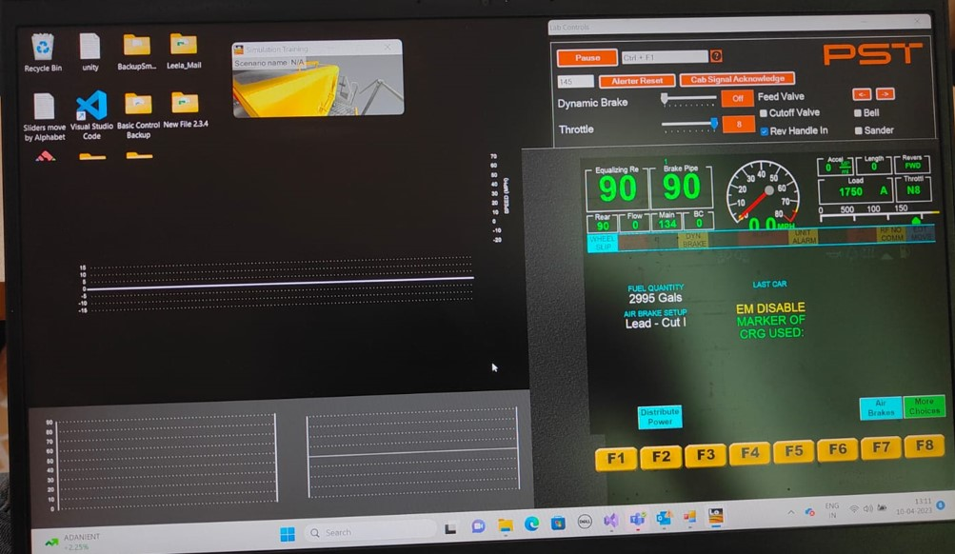
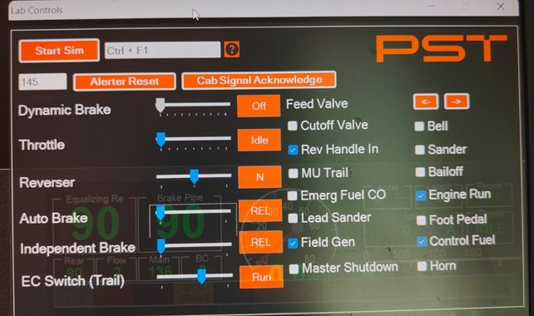
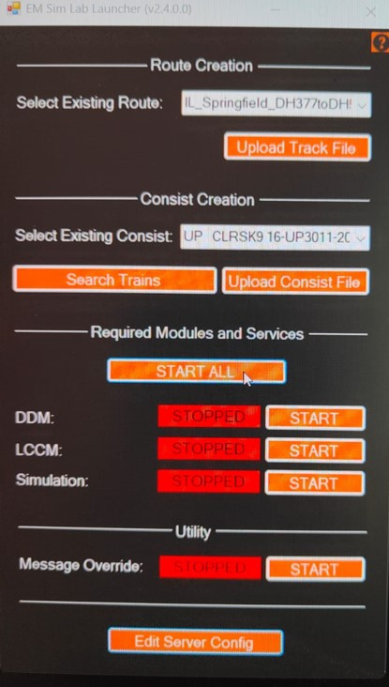
PS Technology
It’s a Train Simulation for Locomotive engineers to build there memory muscles.
Based on Windows Form / Unity / C++ / Graphics Library / Hardware Device Which is called Sim.

Slide 13
It’s a Train Simulation for Locomotive engineers to build there memory muscles.
Based on Windows Form / Unity / C++ / Graphics Library / Hardware Device Which is called Sim.

Slide 14
Roulette Casino
It’s a real-time 3D multiplayer Game on a single table thousands of people can play this game.
Based on Unity / C# / PHP Backend / For Android Mobiles.
Link: Not available.

Slide 15
THANK YOU

